Slide 1
Object Oriented Programming using Unity/C#
Erik Kesa

Slide 2
Fundamentals of OOP
Encapsulation
Abstraction
Inheritance
Polymorphism
Composition

Slide 3
Encapsulation
What: a way to restrict access to data members or methods in a class or object.
Why: limit other code from using methods that they should not use and hide the internal logic behind a public using interface.
How:
Limit access by using private (accessible only to the class itself), public (accessible everywhere) and protected (accessible to the class and any derived classes) keywords in C#
Design your classes in a way, where all internal logic is hidden behind a usable public interface
Encapsulate similar logic into classes (Single Responsibility Principle of SOLID programming)

Slide 4
Abstraction
What: the process of taking away or removing characteristics from something in order to reduce it to a set of essential characteristics. Usually in game design, a concrete implementation of an enemy from a prototype would be broken up into an abstract base class to allow easier creation of new enemies.
Why: in order to make reusable base classes and to decrease the amount of work needed for future functionality.
How:
abstract keyword in front of a class definition in C# allows a class to be labeled as Abstract, meaning that it will not be usable directly in code, but is aimed to serve as a class to derive from.
abstract keyword in front of a method definition in C# allows for a method to be only declared without any implementation provided - such a method will be required to implement in the derived class

Slide 5
Inheritance
What: the ability of a class to derive from an existing class ( become a sub-class of an existing superclass) or to implement an interface (implement methods described in an interface contract)
Why: deriving from an existing base class inherits all of the public and protected methods already implemented in the base class. Implementing an interface makes this class usable in other logic, that is implemented against that interface.
How:
Deriving from a base class (All unity scripts derive by default from the MonoBehavior class) - A class inherits all public or protected data and methods, but may only inherit from one base class.
Implementing a pre-existing interface or creating a new interface to separate logic from implementation. A class may implement multiple interfaces, but interfaces may only define methods, and not data.

Slide 6
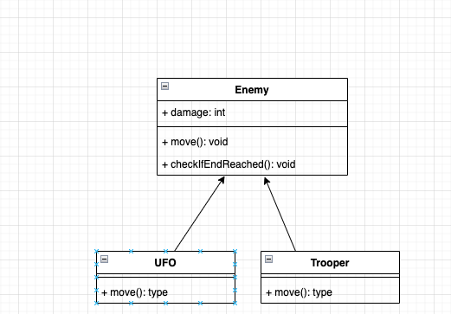
Abstraction and encapsulation - Adding more enemy types

Slide 7
Polymorphism
What: The ability for subclasses to implement methods with different implementations than the base class.
Why: Polymorphism allows for subclasses to define their own functionality, that may match the interface of the base class, but differ in how that functionality is achieved or the side effects necessary.
How:
Run-Time polymorphism can be achieved using the C# keyword override - a Subclass overrides either an abstract or a virtual method defined in a base class
Run-Time polymorphism can be achieved by using the new keyword in the method signature.
Compile-time polymorphism allows for overloading - providing multiple methods with the same name, but with different types of arguments or different return values

Slide 8
Composition
What: Build Classes/Behaviours by combining many small base classes, that each offer some bits of functionality necessary.
Why: Instead of having big classes, it is easier to make a lot of small scripts each handling some aspect of logic needed and to combine them as per requirements. Having many reusable components decreases time necessary to create new content.
How:
Unity - Component pattern
If a class gets too big - consider splitting it into separate classes.
If an object has too much state, consider breaking it up into smaller objects.

Slide 9
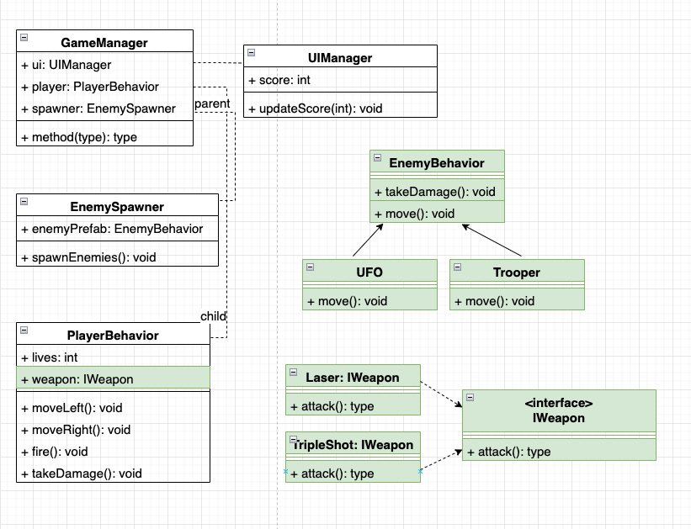
Updating our game

